Slide 1
“Future jobs, current challenges”
HIGH LEVEL CONFERENCE ORGANISED BY THE EU PRESIDENCY OF CROATIA
PARTICIPATION OF WOMEN ON THE LABOUR MARKET – BENEFIT FOR THE SOCIETY
Presentation by Maria Jepsen, Deputy Director, Eurofound
Zagreb, 30 - 31 January 2020

Slide 2
Employment rates EU-28 (M/F) 2008 - 2018
Source: Eurofound, mimeo

Slide 3
Difference between M/F employment rates in percentage points, 2008 – 2018 , EU-28
Source: Eurofound, mimeo

Slide 4
Cost of the Gender Employment Gap in billions Euros, 2008 -2018, EU - 28
Source: Eurofound, mimeo

Slide 5
Drivers of labour market shifts
Labour market shifts driven by :
Technological change
Change in globalisation and new international competition
Environmental concerns
Demographics
Driven by labour demand and supply (upskilling and decrease)
They all have different implications for labour market and skill needs

Slide 6
Drivers of labour market shifts
Technological change:
three vectors
Automation of work
Globalisation
Continued outsourcing – off-shoring of mid-level jobs.
Environmental concerns
New types of jobs: adding to bottom and mid-level segment.
Digitisation of processes
Coordination by platforms.
Care: adding to low and mid-level skills segment, but low-paid.
Demography

Slide 7
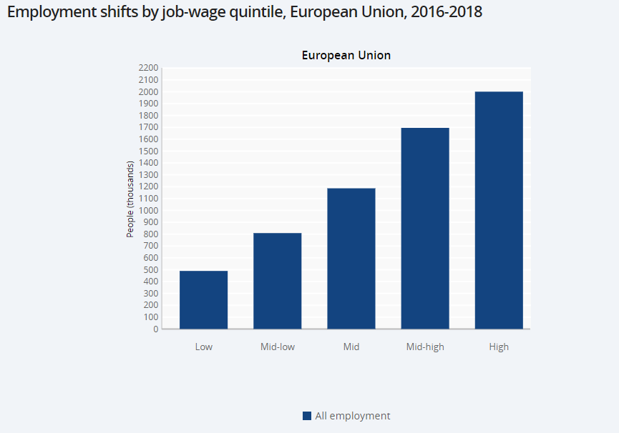
European Jobs Monitor - The ‘jobs approach’: Methodology
‘Jobs approach’ first used by J. Stiglitz and refined by E.O. Wright / R.Dwyer, USA in the 1990s
Concept/objectives:
To describe structural change in the labour market using the job as a unit of observation. A job is an occupation in a sector.
To add a qualitative dimension to net employment change data (Labour Force Survey), e.g. using mean hourly job wage (as a proxy of job quality).
Where – in what sectors, occupations – are new jobs being created and destroyed in EU labour markets?
What are the implications for aggregate employment quality?
Consult interactively all country and EU28 data 2008-18 at https://www.eurofound.europa.eu/data/european-jobs-monitor

Slide 8
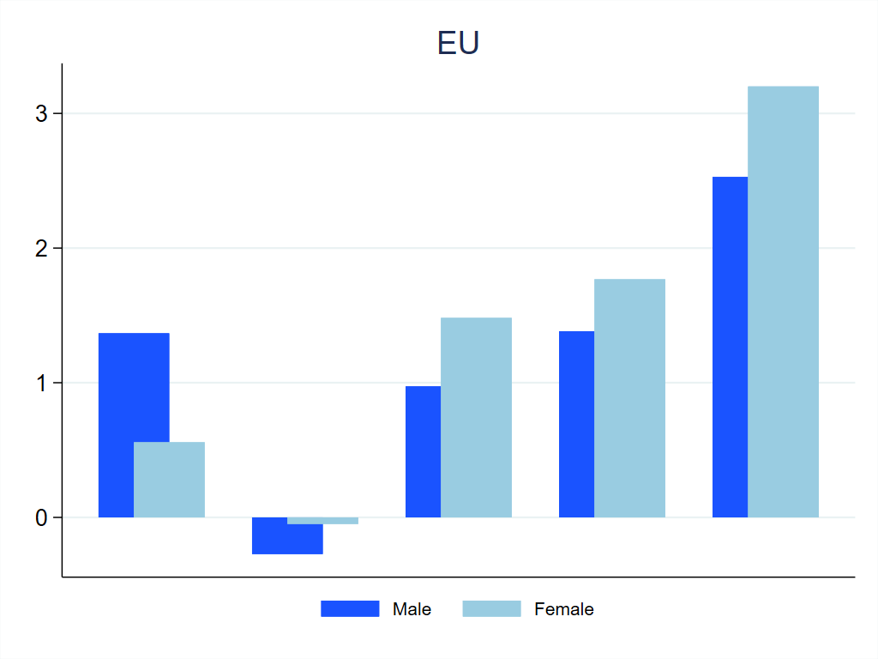
Employment shifts by gender and job-wage quintile, 2011-18, EU (millions)
Source: https://www.eurofound.europa.eu/data/european-jobs-monitor

Slide 9
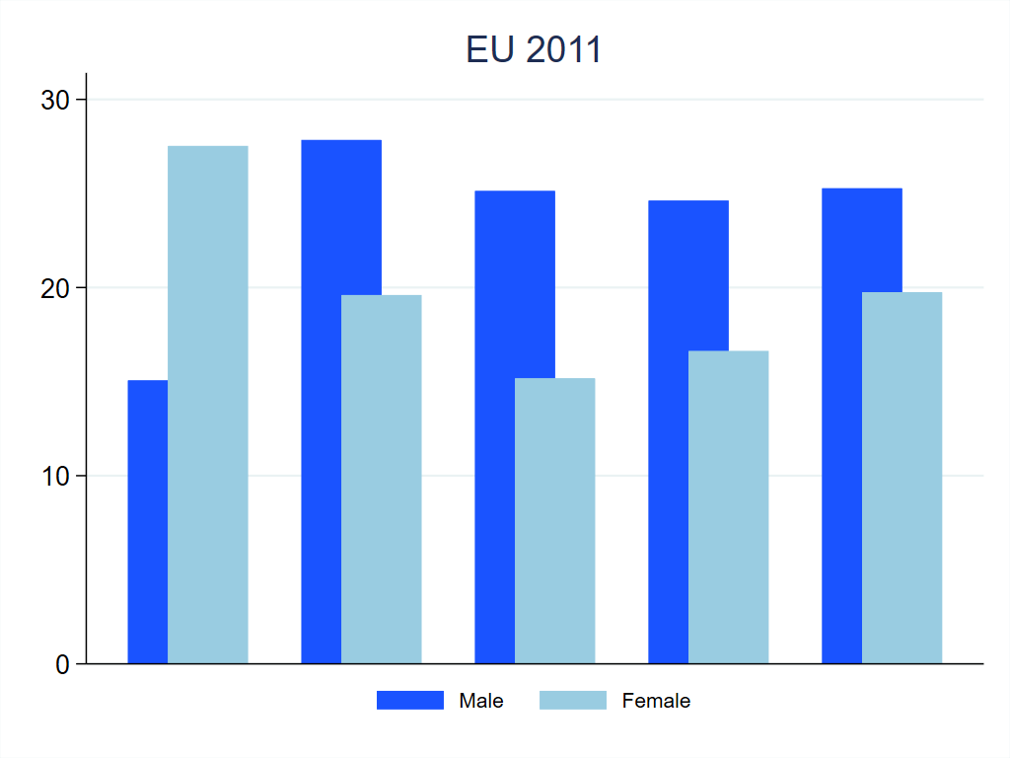
Employment distribution by gender and job-wage quintile, 2011, EU (millions)
Source: https://www.eurofound.europa.eu/data/european-jobs-monitor

Slide 10
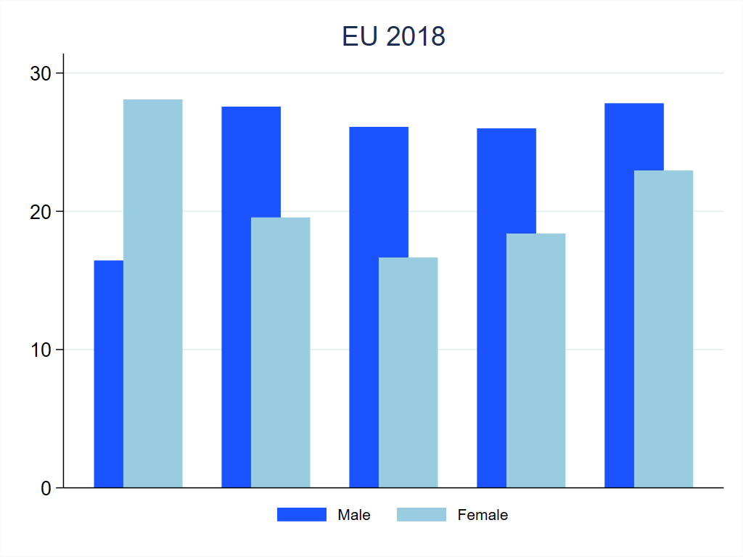
Employment distribution by gender and job-wage quintile, 2018, EU (millions)
Source: https://www.eurofound.europa.eu/data/european-jobs-monitor

Slide 11
Projections for the Future

Slide 12
Employment change by occupation, 2015-2030
Source: CEDEFOP (2018)

Slide 13
Employment change (% per year) by job-wage quintile, 2015-2030
Source: Eurofound (2018)

Slide 14
Change in the task indices in the EU, 2015 to 2030
Source: Eurofound (2018)

Slide 15
Skills and discretion – Access to training, 2015
40% M 40% W
Share of employees who received training paid by their employer
Source: Gender equality at work, Eurofound, forthcoming

Slide 16
Skills and discretion – Access to training, 2015
← Male dominated
Mixed
Female → dominated
Gender equality at work, Eurofound, forthcoming
Source:

Slide 17
Forthcoming…
Notes:
And finally in connection with the future of jobs

Slide 18
Policies fostering participation
Labour market policy measures
Childcare support measures
Leave policies
Flexible working time and work-family reconciliation
To offer support with costs and provision of childcare supporting labour market participation
To encourage greater female labour supply
and greater employer demand
To combine work and family responsibilities and improve work-life balance
For maternity and parenthood-related reasons and adult care
Source: The gender employment gap: challenges and solutions, Eurofound, 2016

Slide 19
Thank you !

